Slide 1
Linux Lift & Shift WDS
Microsoft Cloud Workshop Diagrams

Slide 2










Fabrikam Current Trouble Ticket System
Tokyo vCenter
VLAN40: 172.16.40.0/24
Internet
FGMO Customers & Partners
osticket
172.16.40.12
Intranet
Tokyo Datacenter
FGMO Support Teams

Slide 3









Phase I: Lift & Shift to Azure IaaS
Region: Japan East
MySQLVNet
Address Space: 10.0.0.0/24
Subnet data: 10.0.0.0/24
OsticketVNet
Address Space: 192.168.0.0/20
Subnet Osticket: 192.168.0.0/24
VNet Peering
osticket0
10.0.0.4
osticket1
10.0.0.5
osticket2
10.0.0.6
Osticket
Scale Set
192.168.0.4-X
AV SET: osticket
Resource Group:
OsTicketMySQLVMRG
Resource Group:
OsTicketVMSSRG
Subnet: Data
SRC: 192.168.0.0/24 - TCP - *
DST: 10.0.0.0/24 - TCP - 3306
Subnet: osticket
SRC: INTERNET - TCP – *
DST: 192.168.0.0/24 - TCP - 80, 443
KeyVault:
Certs, Keys, Secrets

Slide 4
Phase I: Lift & Shift to Azure IaaS
Region: Japan East
MySQLVNet
Address Space: 10.0.0.0/24
Subnet data: 10.0.0.0/24
OsticketVNet
Address Space: 192.168.0.0/20
Subnet Osticket: 192.168.0.0/24
VNet Peering
osticket0
10.0.0.4
osticket1
10.0.0.5
osticket2
10.0.0.6
Osticket
Scale Set
192.168.0.4-X
AV SET: osticket
Resource Group:
OsTicketMySQLVMRG
Resource Group:
OsTicketVMSSRG
Subnet: Data
SRC: 192.168.0.0/24 - TCP - *
DST: 10.0.0.0/24 - TCP - 3306
Subnet: osticket
SRC: INTERNET - TCP – *
DST: 192.168.0.0/24 - TCP - 80, 443
KeyVault:
Certs, Keys, Secrets

Slide 5




Phase II: Migration to Azure PaaS
Region: Japan East
KeyVault:
Certs, Keys, Secrets
/OsTicket
SRV: osticketmysql
DB: osticket
https://osticketsystem.azurewebsites.net
Resource Group:
OsTicketPaaSRG

Slide 6








Phase I: Lift & Shift to Azure IaaS
FGMO Customers & Partners
Internet
SSL
Azure
Application Gateway
Osticket
Scale Set
192.168.0.4-X
Peering
osticket
OsTicketVNET 192.168.0.0/24
Local
Gateway
Failover
VPN
Gateway
AZDC1
Peering
FGMO Support Teams
ExpressRoute
ER
Gateway
Routers
GatewaySubnet
AZDC2
Users VLAN
VLAN40
DMZ
AD
Peering
172.16.0.0/20
data
osticket0
10.0.0.100
osticket1
10.0.0.5
osticket2
10.0.0.6
FGMOITVNET
172.16.41.0/26
MySQLVNET 10.0.0.0/24
Tokyo Datacenter
Region: Japan East

Slide 7
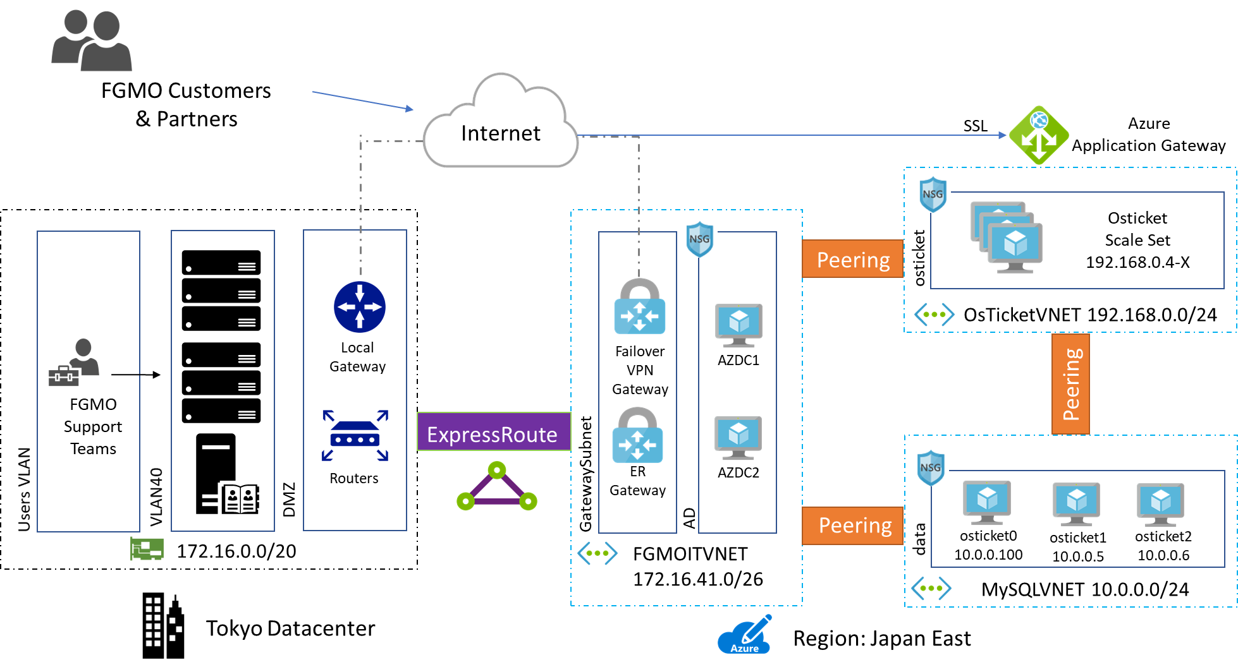

Slide 8
Phase II: Lift & Shift to Azure PaaS
FGMO Customers & Partners
SSL
Internet
Azure
Application Gateway
Fabric
Local
Gateway
Failover
VPN
Gateway
AZDC1
https://osticketsystem.azurewebsites.net
FGMO Support Teams
ExpressRoute
Fabric
ER
Gateway
Routers
GatewaySubnet
AZDC2
Users VLAN
VLAN40
DMZ
AD
SRV: osticketmysql
DB: osticket
KeyVault:
Certs, Keys, Secrets
172.16.0.0/20
FGMOITVNET
172.16.41.0/26
Tokyo Datacenter
Region: Japan East

Slide 9
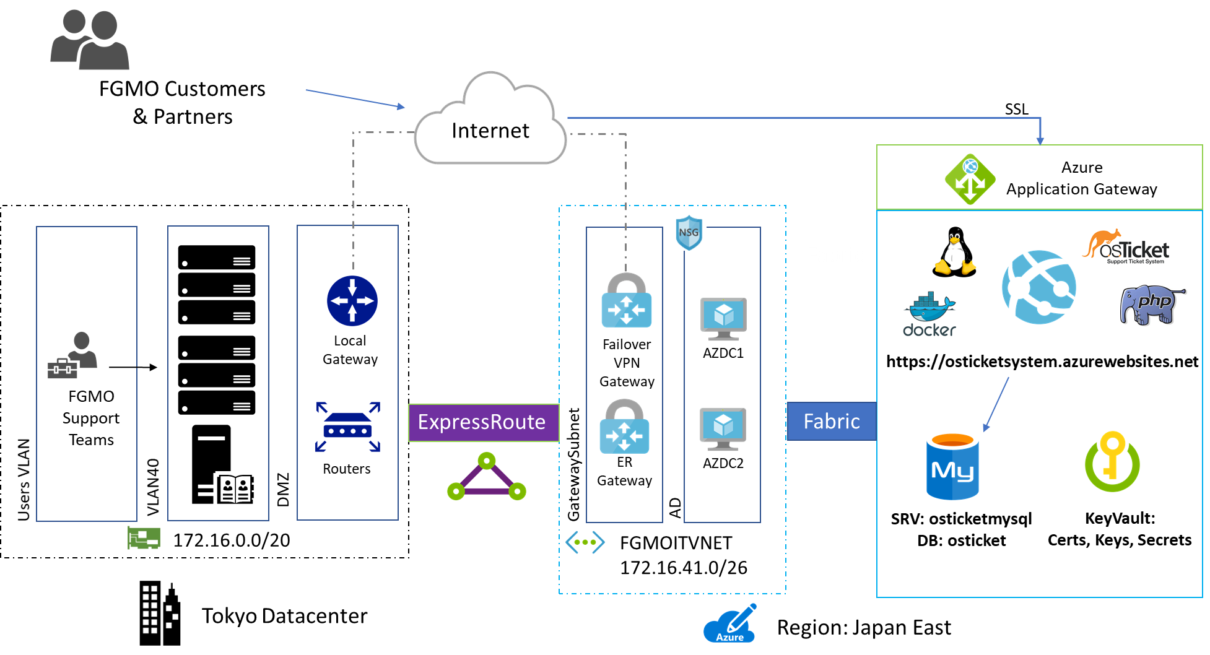

Slide 10
Linux Lift & Shift HOL
Microsoft Cloud Workshop Diagrams

Slide 11
OnPremVM
OnPremVNet
Address Space: 10.0.0.0/24
Subnet “osticket”: 10.0.0.0/24
OnPremVM
10.0.0.4
Resource Group:
OsTicketOnPremRG

Slide 12
Phase I: Lift & Shift to Azure IaaS
MySQLVNet
Address Space: 10.0.0.0/24
Subnet data: 10.0.0.0/24
OsticketVNet
Address Space: 192.168.0.0/20
Subnet Osticket: 192.168.0.0/24
VNet Peering
osticket0
10.0.0.4
osticket1
10.0.0.5
osticket2
10.0.0.6
Osticket
Scale Set
192.168.0.4-X
Resource Group:
OsTicketMySQLVMRG
Resource Group:
OsTicketVMSSRG

Slide 13
Phase II: Migration to Azure PaaS
/OsTicket
http://osticketsystem.azurewebsites.net
SRV: osticketmysql
DB: osticket
Resource Group:
OsTicketPaaSRG

